Slide 1
TEACHER CUE
CFU
HINT
Scaffolding for students
MAKE THE CONNECTION
Allow students to make the connection

Slide 2
We will be able to describe how the respiratory and circulatory systems are linked
TRACK WITH ME
READ WITH ME
I can describe the function of the alveoli
I can describe how the respiratory and circulatory systems are linked

Slide 3
We will be able to describe how the respiratory and circulatory systems are linked
MAKE THE CONNECTION
What is the function of the ciculatory system?
What is the function of the respiratory system?

Slide 4
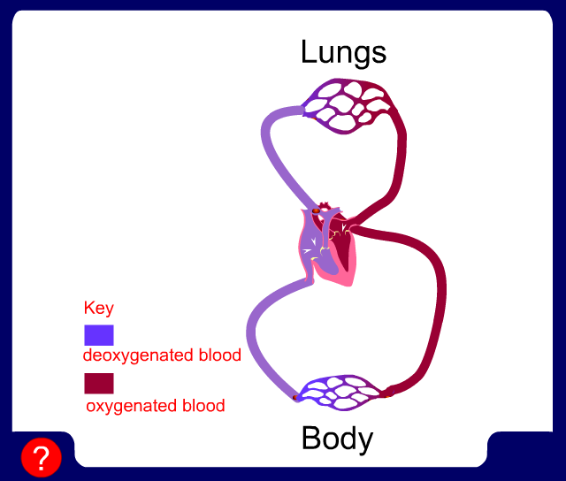
We will be able to describe how the respiratory and circulatory systems are linked
The circulatory acts to transport oxygen dissolved in your blood around the body to tissues.
The respiratory system takes in oxygen and expels carbon dioxide.

Slide 5
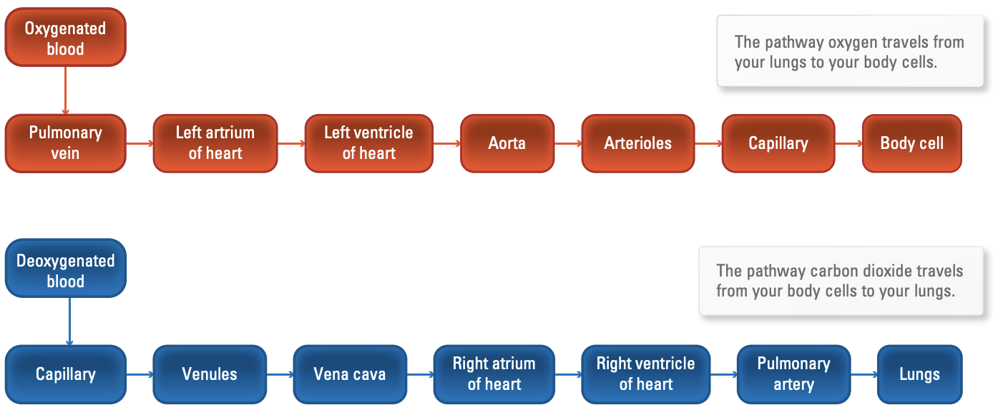
We will be able to describe how the respiratory and circulatory systems are linked
Notes:
The blood that it travels in is referred to as oxygenated blood. The oxygenated blood travels from your lungs via the pulmonary vein to the left atrium of your heart. From here, it travels to the left ventricle where it is pumped under high pressure to your body through a large artery called the aorta. The oxygenated blood is then transported to smaller vessels (arterioles) and finally to capillaries through which it diffuses into body cells for use in cellular respiration.

Slide 6
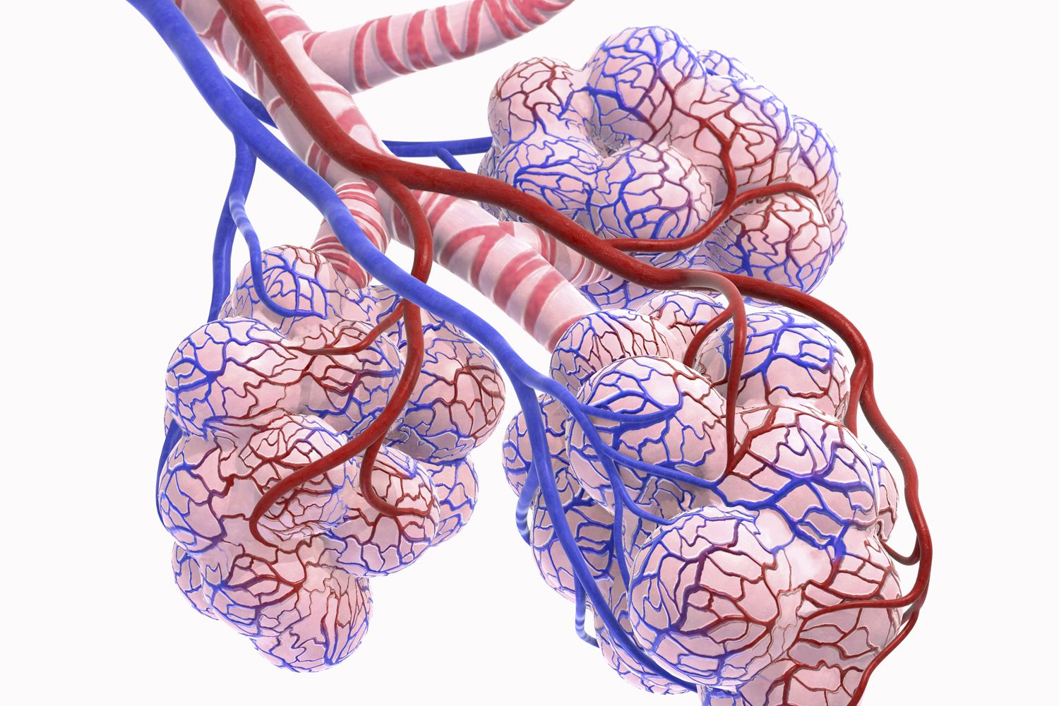
We will be able to describe how the respiratory and circulatory systems are linked
HINT
Diffuses= spreads out into a new area
Your circulatory and respiratory systems work together to get oxygen to your cells.
Once you have breathed in and oxygen has reached your alveoli, oxygen diffuses into red blood cells in capillaries that surround the alveoli.

Slide 7
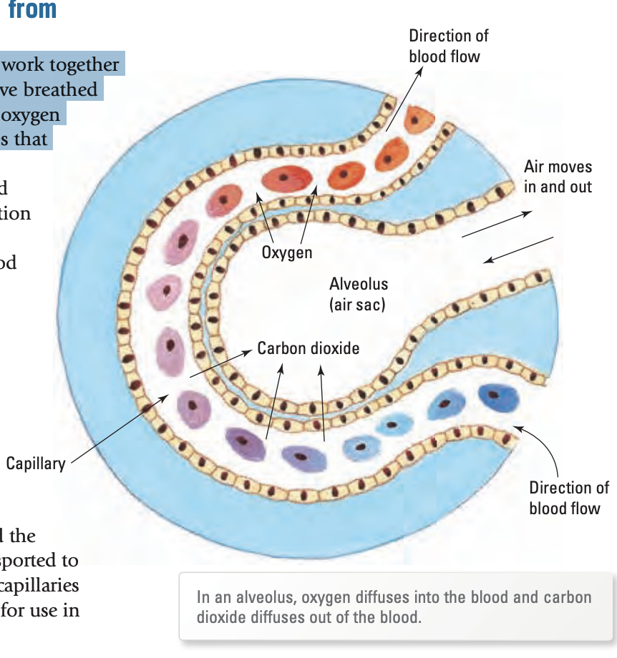
We will be able to describe how the respiratory and circulatory systems are linked
Alveoli
Draw this diagram of your alveoli in your book

Slide 8
We will be able to describe how the respiratory and circulatory systems are linked
Once this oxygen from your alveoli enters the blood it is then transferred around the body to tissues and cells that need oxygen.
This is how deoxygenated blood becomes oxygenated again.

Slide 9
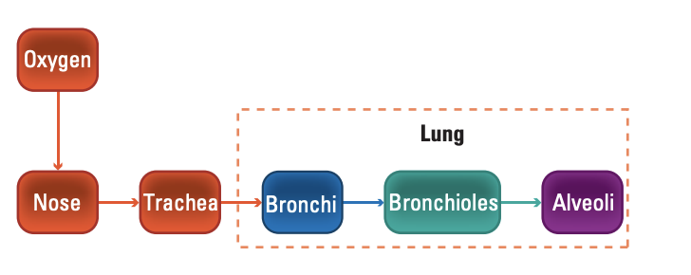
We will be able to describe how the respiratory and circulatory systems are linked
How is the respiratory system involved?
The lungs are involved in both the circulatory and respiratory system.
Capillaries ➔ Blood

Slide 10
We will be able to describe how the respiratory and circulatory systems are linked
TRACK WITH ME
READ WITH ME
I can describe the function of the alveoli
I can describe how the respiratory and circulatory systems are linked

